Slide 1
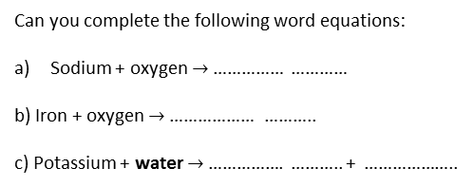
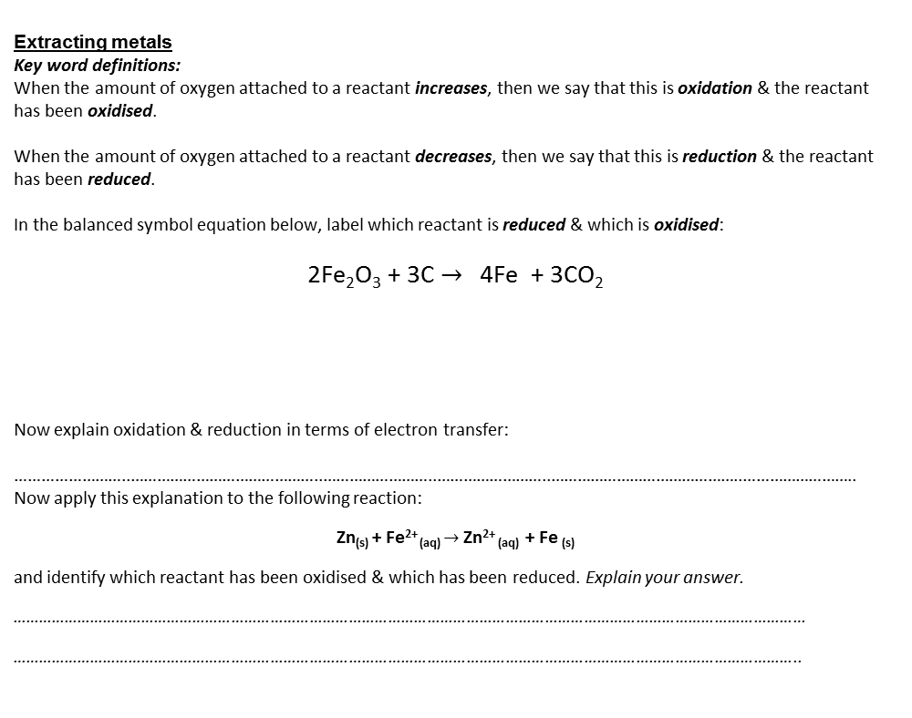
The reactivity series
List the order of common metals in the reactivity series:
……………………..
……………………..
……………………..
……………………..
……………………..
……………………..
……………………..
……………………..
……………………..
……………………..
Can you think up a sentence to help you remember this list?
……………………..…………………….. ……………………..……………………..
Displacement reactions
Use the reactivity series to determine whether a reaction between a metal and a different metal salt would happen or not. If it will happen then write out the remainder of the word equation to show all the products:
Iron + zinc sulphate $→$
Magnesium + copper chloride $→$
Copper + iron nitrate $→$
Explain why carbon will reduce iron oxide but not magnesium oxide:
……………………………………………………………………………….
………………………………………………………………………………. ……………………………………………………………………………….
Can you complete the following word equations:
Sodium + oxygen $→$ …………… …………
b) Iron + oxygen $→$ ……………… ………..
c) Potassium + water $→$ ……………. ……….. + ………………..
Extracting metals
Key word definitions:
When the amount of oxygen attached to a reactant increases, then we say that this is oxidation & the reactant has been oxidised.
When the amount of oxygen attached to a reactant decreases, then we say that this is reduction & the reactant has been reduced.
In the balanced symbol equation below, label which reactant is reduced & which is oxidised:
2Fe₂O₃ + 3C $→$ 4Fe + 3CO₂
Now explain oxidation & reduction in terms of electron transfer:
……………………..……………………………………..……………………..……………………..……………………………………..……………………..
Now apply this explanation to the following reaction:
Zn_{(s)} + Fe²⁺ _{(aq)} $→$Zn²⁺ _{(aq)} + Fe _{(s)}
and identify which reactant has been oxidised & which has been reduced. Explain your answer.
…………………………………………………………………………………………………………………………………………………………………
………………………………………………………………………………………………………………………………………………………………..
Salts
1) Complete this general equation:
metal + acid $→$ …………… + hydrogen
2) Now use it to help you fill in the missing product in this word equation:
Zinc + hydrochloric acid → ……… …………… + hydrogen
3) Name the type of salt produced with each acid. The first one has been done for you:
4) Fill in the gaps in the following word equations:
Sulphuric acid + sodium → sodium ____________ + hydrogen
Hydrochloric acid + copper →copper __________ + _____________
Nitric acid + ___________ → zinc _____________ + hydrogen
___________ acid + __________ →iron phosphate + ____________
Challenge task: a student reacts copper (II) oxide with sulphuric acid. Can you write the following word equation for this reaction?
→
……………………..……………………………………..……………………..
Breaden bonus:
Now write the balanced symbol equation, with correct state symbols:
→
…………………………………………………………………………………….
ACID |  | TYPE OF SALT
Sulphuric acid | H₂SO₄ | SULPHATE
Hydrochloric acid | HCl
Nitric acid | HNO₃
Phosphoric acid | H₃PO₄

Slide 2
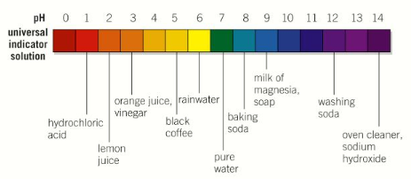
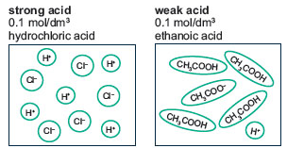
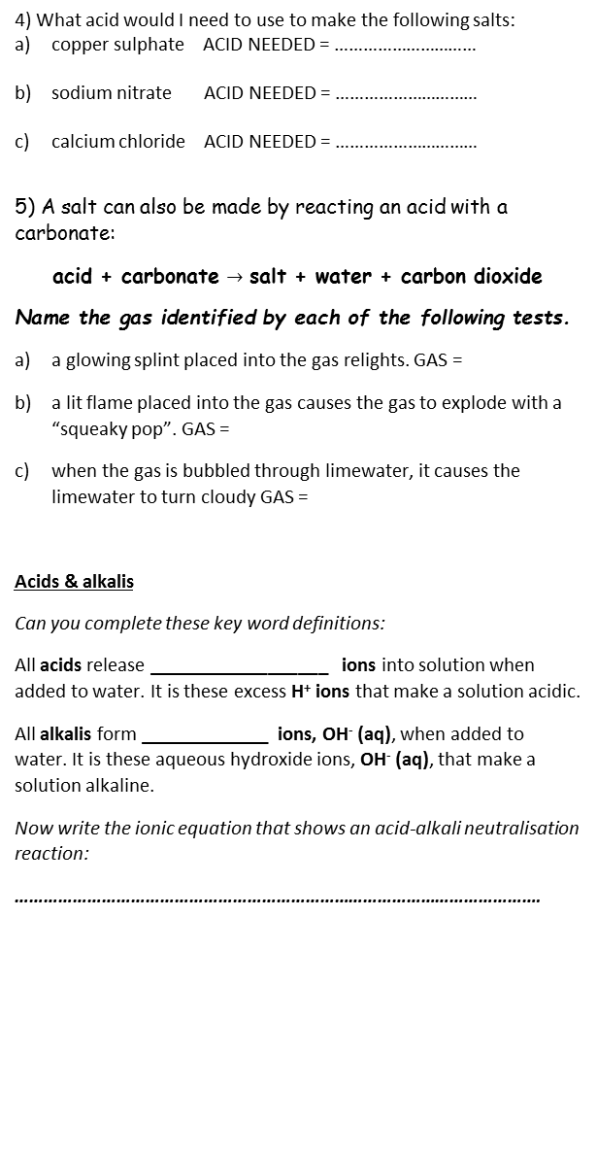
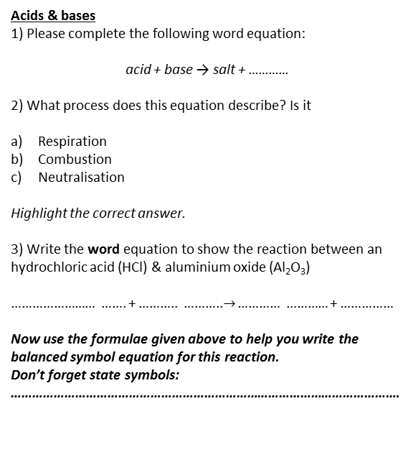
More salts
A student wants to make a pure, dry sample of copper (II) chloride salt crystals, using copper (II) oxide & hydrochloric acid as the reactants. Describe & explain a method that could be used. You should be careful to list the equipment that you would use:
……………………..……………………………………..……………………..
……………………..……………………………………..…………………….. ……………………..……………………………………..…………………….. ……………………..……………………………………..…………………….. ……………………..……………………………………..…………………….. ……………………..……………………………………..…………………….. ……………………..……………………………………..…………………….. ……………………..……………………………………..…………………….. ……………………..……………………………………..…………………….. ……………………..……………………………………..…………………….. ……………………..……………………………………..…………………….. ……………………..……………………………………..……………………..
4) What acid would I need to use to make the following salts:
copper sulphate ACID NEEDED = …………………………
sodium nitrate ACID NEEDED = …………………………
calcium chloride ACID NEEDED = …………………………
5) A salt can also be made by reacting an acid with a carbonate:
acid + carbonate $→$ salt + water + carbon dioxide
Name the gas identified by each of the following tests.
a glowing splint placed into the gas relights. GAS =
a lit flame placed into the gas causes the gas to explode with a “squeaky pop”. GAS =
when the gas is bubbled through limewater, it causes the limewater to turn cloudy GAS =
Acids & alkalis
Can you complete these key word definitions:
All acids release __________________ ions into solution when added to water. It is these excess H⁺ ions that make a solution acidic.
All alkalis form _____________ ions, OH⁻ (aq), when added to water. It is these aqueous hydroxide ions, OH⁻ (aq), that make a solution alkaline.
Now write the ionic equation that shows an acid-alkali neutralisation reaction:
……………………………………………………………………………………………….
The pH scale
Label up the pH scale below with as much information as you can. E.g. strong acid, weak acid etc.
What does the pH scale measure?
……………………………………………………………………………………………………………………
Choose from NEUTRAL, ALKALINE & ACIDIC to fill in the gaps:
pH < 7.0 indicates an ____________ solution i.e. pH values are less than 7.0
pH > 7.0 indicates an ____________ solution i.e. pH values are greater than 7.0
pH = 7.0 indicates a __________ solution
If a solution is pH 7, we call it neutral, but explain this in terms of the concentration of H⁺ & OH⁻ ions:
……………………………………………………………………………………………………………………………
Acids & bases
1) Please complete the following word equation:
acid + base → salt + …………
2) What process does this equation describe? Is it
Respiration
Combustion
Neutralisation
Highlight the correct answer.
3) Write the word equation to show the reaction between an hydrochloric acid (HCl) & aluminium oxide (Al₂O₃)
…………………… ……. + ……….. ………..$→$ ………… ………… + ……………
Now use the formulae given above to help you write the balanced symbol equation for this reaction.
Don’t forget state symbols:
……………………………………………………………………………………………….
Explain how we know which is the weak & which the strong acid:
………………………………………………………………………………………………………………………………………………………………………

