Slide 1
Produce a flow chart to show how the
Earth’s atmosphere has developed:
Fill in the table to show the percentage of gases in the Earth’s
atmosphere:
Put numbers next to the statements to show the order of events in global warming:
The Sun’s heat passes in through the greenhouse gases and warms up the surface of the Earth.
Greenhouse gases form a layer around the Earth.
The atmosphere warms up. This is called global warming.
The greenhouse gases stop the reflected heat from passing back out into space.
Greenhouse gases like carbon dioxide and methane are added to the atmosphere.
The Sun’s heat is reflected from the surface of the Earth.
Name of gas | Percentage (%) of gas
Nitrogen
Oxygen
Other gases
During the first billion years there
was Intense volcanic activity…
Name 2 greenhouse gases:
The great oxygenation event:
There is a theory that the first organisms carrying out
photosynthesis, _____________.produced oxygen as a
________ product, but that this oxygen was removed by the
____________ of iron to form iron (III) oxide. The _______
For this is iron oxide bands in some areas of rocks.This
Process __________ all the spare oxygen, until there was an
________ which led to a significant rise in the atmosphere
Waste, excess,Cyanobacteria, evidence, captured,oxidation
The Earth’s Atmosphere
When the oceans formed…
Label the diagram to show the greenhouse effect:
Algae and plants…
Carbon dioxide decreased because.
…

Slide 2
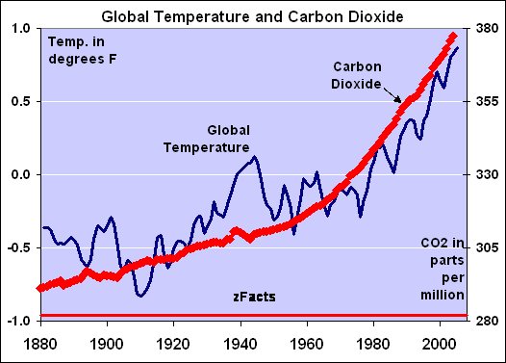
The Earth’s Atmosphere
What is a carbon footprint?
Name 3 alternative energy sources
and describe how they reduce the carbon
Footprint:
Describe how coal was formed:
Describe how this led to a reduction
in carbon dioxide levels:
Describe how limestone was formed:
Explain how plants were essential for
Early animal life to flourish:
Explain the following ways that governments can
reduce the carbon footprint:
Carbon capture:
Carbon off-setting:
Carbon neutrality:
Describe what the graph above shows:
Describe what human activities have led to this change:
Suggest what will happen in the next 50 years if the
temperature increases continue:
pollutant | How it is formed | Effects on environment
Carbon monoxide
particulates
Nitrous oxides
Sulphur dioxide

Slide 3
Produce a flow chart to show how the
Earth’s atmosphere has developed:
Fill in the table to show the percentage of gases in the Earth’s
atmosphere:
Put numbers next to the statements to show the order of events in global warming:
3
The Sun’s heat passes in through the greenhouse gases and warms up the surface of the Earth.
Greenhouse gases form a layer around the Earth.
The atmosphere warms up. This is called global warming.
The greenhouse gases stop the reflected heat from passing back out into space.
Greenhouse gases like carbon dioxide and methane are added to the atmosphere.
The Sun’s heat is reflected from the surface of the Earth.
Name of gas | Percentage (%) of gas
Nitrogen | <80
Oxygen | <20
Other gases | 1
2
During the first billion years there
was Intense volcanic activity…
This released gases such as
carbon dioxide and nitrogen. These gases
Formed the early atmosphere
6
5
1
4
Name 2 greenhouse gases:
methane
carbon dioxide
(water vapour, )
The great oxygenation event:
There is a theory that the first organisms carrying out
photosynthesis, cyanobacteria.produced oxygen as a
waste product, but that this oxygen was removed by the
oxidation of iron to form iron (III) oxide. The evidence
for this is iron oxide bands in some areas of rocks. This
Process captured all the spare oxygen, until there was an
Excess which led to a significant rise in the atmosphere
Waste, excess, Cyanobacteria, evidence, captured, oxidation
The Earth’s Atmosphere
When the oceans formed…
Carbon dioxide dissolved in the water
And carbonates were precipitated
Producing sediments, reducing the
Amount of carbon dioxide in the
atmosphere
Label the diagram to show the greenhouse effect:
Algae and plants…
Photosynthesised and produced
oxygen around 2.7 billion years ago
Light from the sun
Some goes back into space
Thermal energy reaches Earth
More greenhouse
gases mean more
heat is trapped.
Carbon dioxide decreased because.
…it was used up during
photosynthesis
Greenhouse gases
Trap the heat

Slide 4
What is a carbon footprint?
The amount of carbon dioxide and other
Gases emitted over the life cycle of a
Person or event.
Name 3 alternative energy sources
and describe how they reduce the carbon
Footprint:
solar
hydroelectricity
wind
No co2 emissions
The Earth’s Atmosphere
Describe how coal was formed:
Plant deposits were buried and
compressed over millions of years.
Describe how this led to a reduction
in carbon dioxide levels:
Coal is mostly carbon that became
Locked in the ground.
Describe how limestone was formed:
After the appearance of animals, their
Shells and skeletons made of
Calcium carbonate compressed together
Over time, forming limestone.
Explain how plants were essential for
Early animal life to flourish:
Plants removed carbon dioxide and
produced oxygen (and food)
Explain the following ways that governments can
reduce the carbon footprint:
Carbon capture:taking the emissions of carbon dioxide from the
Power station and depositing it into an underground geological
Formation.
Carbon off-setting: Increasing the carbon sink by tree planting
And reforestation.
Carbon neutrality: zero net release eg planting trees that use
as much CO2 as is released.
Describe what the graph above shows:
Since 1880 the levels of carbon dioxide in the
Atmosphere have increased (more rapidly since 1990).
The global temperature has also shown an overall
Increase.
Describe what human activities have led to this change:
Burning more fossil fuels due to an increase in
manufacturing, increased population, and greater use
Of cars and planes.
Deforestation
Suggest what will happen in the next 50 years if the
temperature increases continue:
Polar ice caps will melt leading to increased flooding.
Crops may fail due to higher temperatures.
pollutant | How it is formed | Effects on environment
Carbon monoxide | Incomplete combustion of hydrocarbons | Toxic – prevents blood carrying oxygen
particulates | Incomplete combustion of hydrocarbons | Global dimming
Nitrous oxides | Gases from the air under high temperatures in car engines. | Acid rain
Sulphur dioxide | Sulphur impurities in coal etc. | Acid rain

